Slide 1
Photocatalytic Paint for Roadside Air Pollution Reduction
Group Members
Ronit Kumar Dalai – PRN: SCFU125091
Ajit Ranjit Rajput – PRN: SCFU125113
Shrisha Pramod Patil – PRN: SCFU125093
Course: Applied Chemistry for Engineers
Instructor: Dr. Veeranna Yempally
Topic: Sustainable photocatalytic coatings for reducing roadside air pollution.

Slide 2
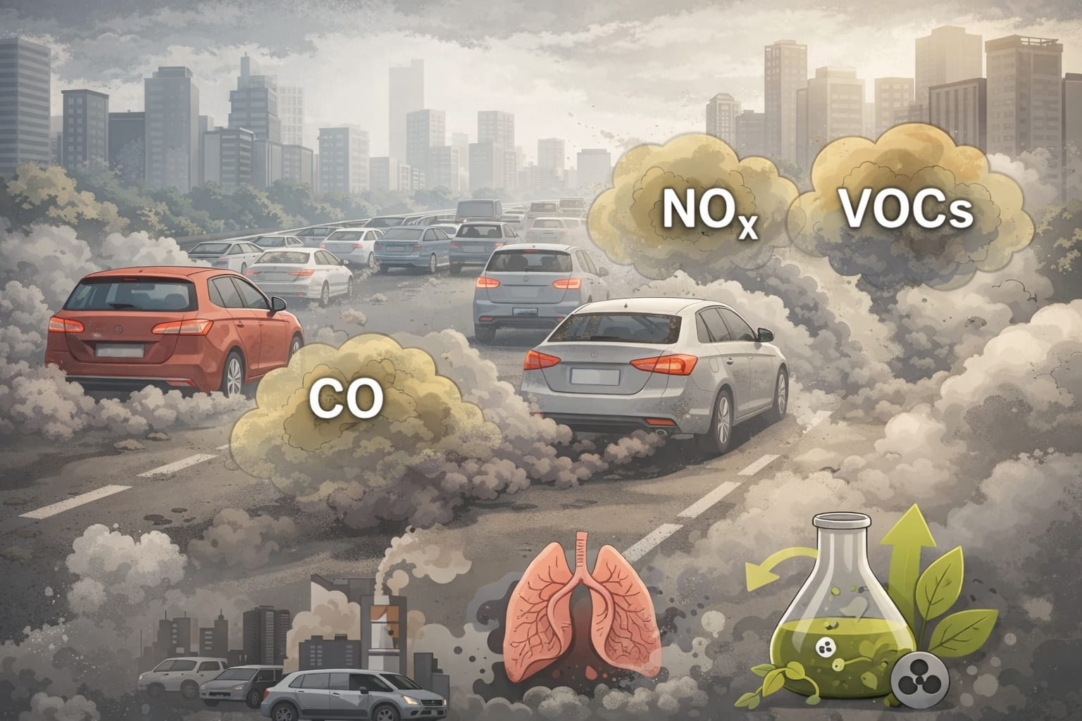
Framing the Problem
Air pollution near roads is increasing due to vehicle emissions.
Major pollutants include nitrogen oxides (NOx), carbon monoxide (CO) and volatile organic compounds (VOCs).
These gases contribute to smog formation, respiratory diseases and environmental damage.
Urban areas with heavy traffic experience higher pollution levels.
There is a need for low‑cost technologies that can reduce pollution directly in the environment.

Slide 3
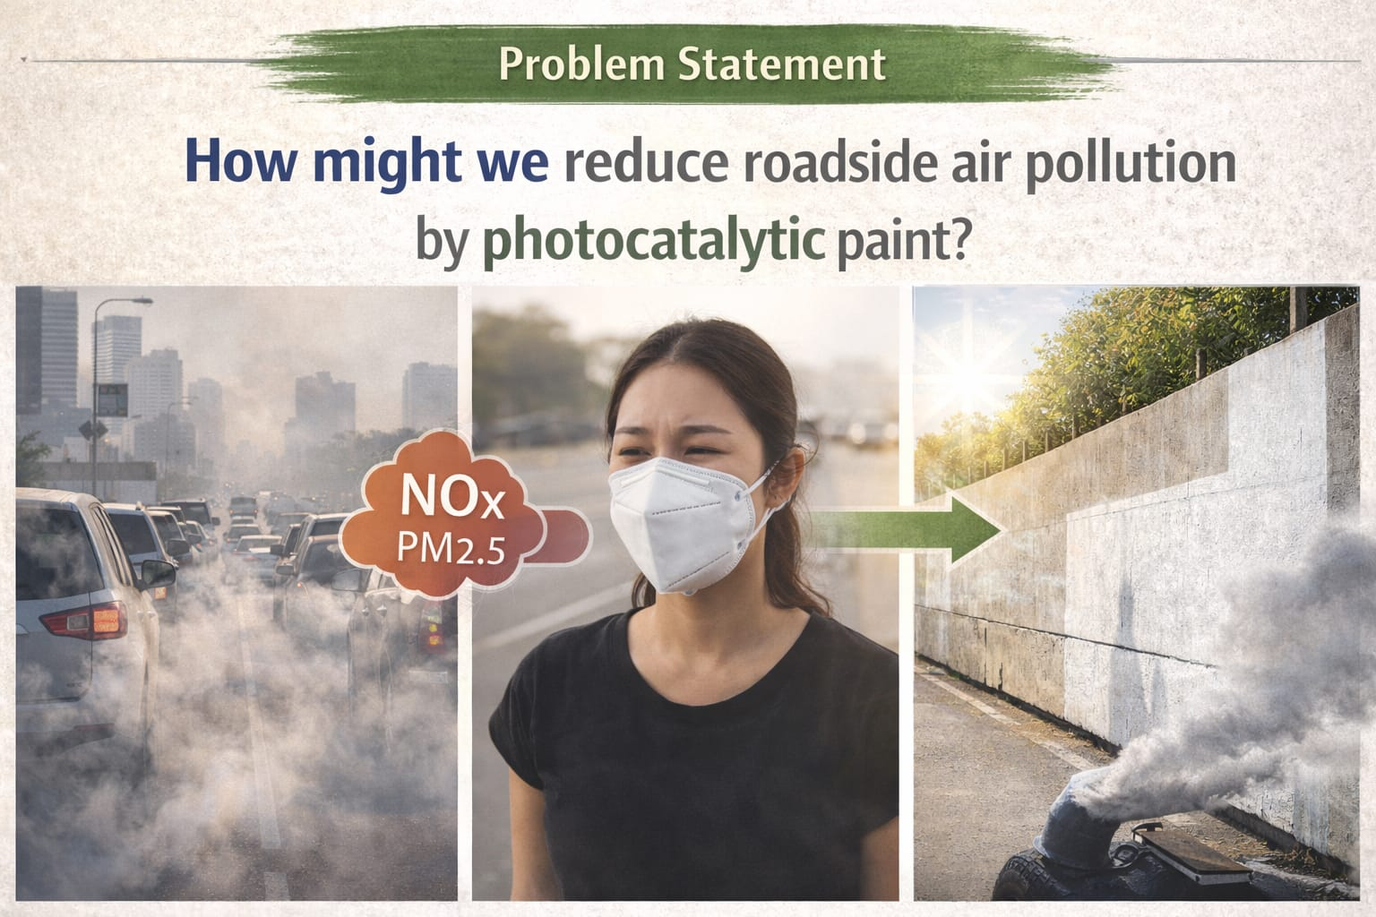
HMW Statement
How Might We (HMW) design an affordable photocatalytic paint that can be applied on roadside walls and infrastructure to reduce harmful air pollutants using sunlight?
Key Goals:
• Reduce NOx and VOC pollutants near roads
• Use natural sunlight as the energy source
• Apply green chemistry principles
• Develop a scalable and sustainable solution for urban environments.

Slide 4
Problem Definition
The core problem is that roadside pollution from transportation emissions is continuously increasing in cities.
To address this problem, we defined three major aspects:
Objectives
Our objectives are:
Reduce harmful air pollutants near roads.
Develop a sustainable pollution reduction technology.
Use photocatalysis driven by sunlight to break down pollutants.
Constraints
However, there are also some limitations:
The system depends on availability of sunlight.
The coating must be durable and long-lasting.
Environmental factors like dust, humidity, and weather can affect performance.

Slide 5
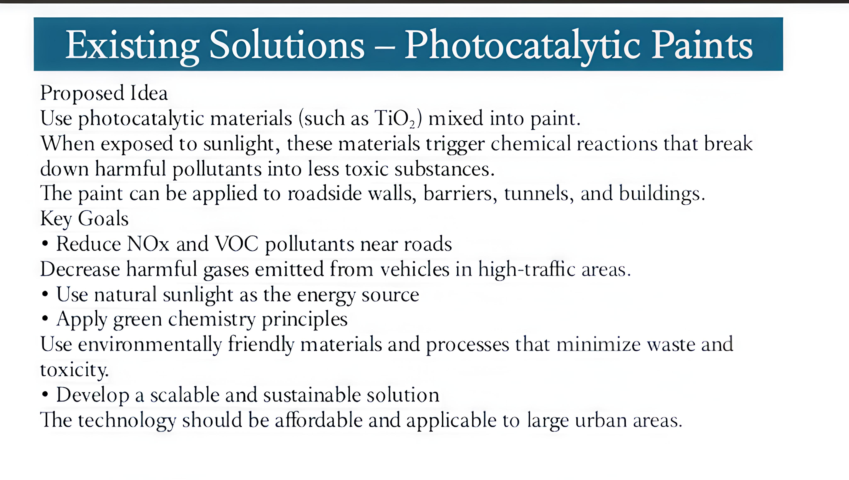
Existing Solutions – Photocatalytic Paints
Many researchers use titanium dioxide (TiO₂) coatings for pollution reduction.
When exposed to sunlight, TiO₂ produces reactive radicals that break down pollutants.
Studies show TiO₂ coatings can degrade nitrogen oxides and VOCs in polluted environments.
These coatings are used in paints, concrete and building surfaces.

Slide 6
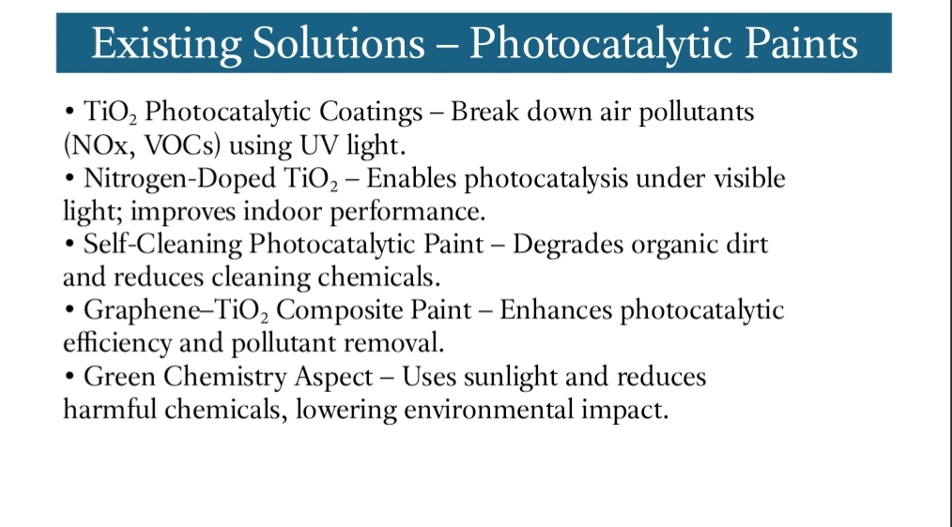
Existing Solutions – Advanced Photocatalysts
Researchers have developed improved photocatalysts such as:
• Nitrogen‑doped TiO₂
• Graphene‑TiO₂ composites
• Metal‑doped TiO₂
These modifications increase photocatalytic efficiency and allow reactions under visible light conditions.

Slide 7
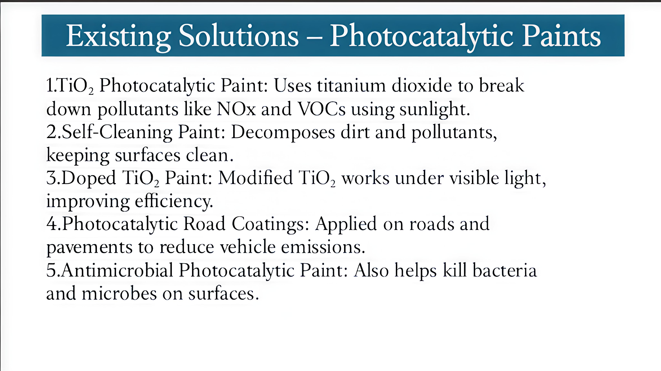

Slide 8
Materials Used in Photocatalytic Paint
Photocatalytic paints contain several important components.
1. Titanium Dioxide Nanoparticles:-
TiO₂ acts as the main photocatalyst responsible for pollutant degradation.
2. Paint Binder:-
Binders such as acrylic or silicate help the paint stick to surfaces like.concrete on walls.
3. Additives:-
Additives improve:
Stability
Adhesion
Durability of the coating.
Together, these materials create a coating capable of initiating photocatalytic reactions when exposed to sunlight.

Slide 9
Photocatalytic Mechanism
When sunlight strikes TiO₂, electrons become excited and move to a higher energy level.
This creates electron‑hole pairs that trigger oxidation reactions.
The reactions produce:
• Hydroxyl radicals
• Superoxide radicals
These reactive species break down pollutants like NOx and VOCs into harmless compounds such as nitrates, carbon dioxide and water.

Slide 10
Laboratory Research Advances
Many laboratory experiments have tested the effectiveness of photocatalytic coatings.
Results show that TiO₂ coatings can remove about 20% of nitrogen oxide pollutants under controlled conditions.
Advanced nanomaterials can achieve even higher removal efficiencies.
Researchers also study several important factors that influence
performance:
Humidity
Light intensity
Amount of catalyst used
By optimizing these factors, scientists are improving the efficiency of photocatalytic materials.

Slide 11
Field Applications
Photocatalytic paints have already been tested in real-world environments.
Some applications include:
Roadside concrete walls
Building facades
Tunnel interiors
Urban pavements
Field experiments have shown localized reduction of pollutants near coated surfaces.
Some studies reported NOx reduction between 5% and 20% in urban environments.

Slide 12
Challenges and Limitations
Despite the advantages, there are still some challenges.
First, the efficiency depends heavily on sunlight intensity.
Second, dust and pollution particles can cover the catalyst surface and reduce its activity.
Third, weather conditions such as rain, humidity, and temperature may affect the durability of the coating.
Another limitation is that large-scale pollution reduction requires coating very large surface areas, which may increase cost.
Therefore, researchers are working on improving efficiency and durability.

Slide 13
Future Trends and Industry Outlook
Future research in this field is focused on developing more efficient photocatalysts.
Scientists are working on:
Visible-light active catalysts that work even without strong sunlight.
Nanostructured photocatalysts for higher efficiency.
Self-cleaning surfaces that maintain catalytic activity for longer.
In the future, smart city infrastructure may integrate photocatalytic coatings into:
Buildings
Roads
Public infrastructure

Slide 14
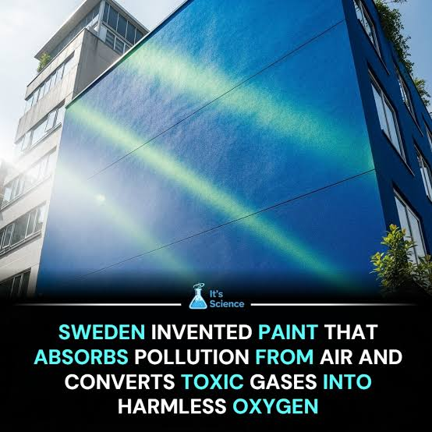
The paint functions as a "passive" air purifier using a process called photocatalysis:
1. Activation: Sunlight (UV rays) hits the titanium dioxide (TiO2) nanoparticles in the paint.
2. Reaction: The energized particles react with moisture in the air to create reactive "hydroxyl radicals".
3.Neutralization: These radicals attack pollutant molecules (like smog-causing NO), decomposing them into nitrate salts that are later washed away by rain.

Slide 15
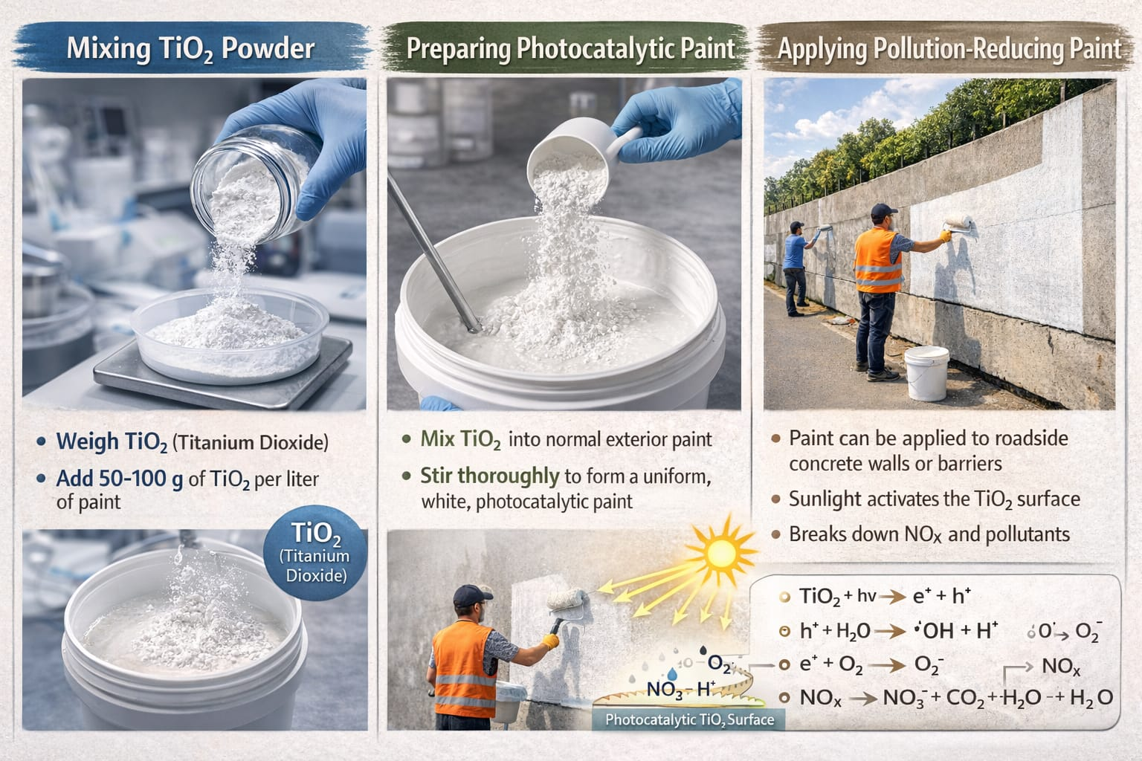
Proposed Solution
Our proposed solution is to develop a low-cost photocatalytic paint for roadside surfaces.
The method includes:
Mixing Titanium Dioxide powder with standard exterior paint.
Applying this paint on roadside walls and barriers.
When sunlight strikes the surface, the photocatalytic reaction begins.
Pollutants near the surface are broken down into harmless compounds.
This approach is simple, cost-effective, and can be implemented on existing urban infrastructure.

Slide 16
Sustainability and Green Chemistry
Our solution follows several green chemistry principles.
Catalysis:-
TiO₂ acts as a catalyst and is not consumed during the reaction.
Energy Efficiency:-
The system uses sunlight as the energy source, reducing external energy requirements.
Pollution Prevention:-
Instead of treating pollution later, this method breaks down pollutants immediately in the environment.
Environmentally Safe Materials:-
Titanium dioxide is non-toxic, stable, and widely available, making it environmentally safe.
These features make the solution sustainable and eco-friendly.

Slide 17
Impact of the Solution
If implemented successfully, this technology can have several positive impacts:
Reduce air pollution near busy roads
Improve public health
Lower the risk of respiratory diseases
Support sustainable urban development
Contribute to cleaner and healthier cities
Even small reductions in pollution can significantly improve urban air quality over time.

Slide 18
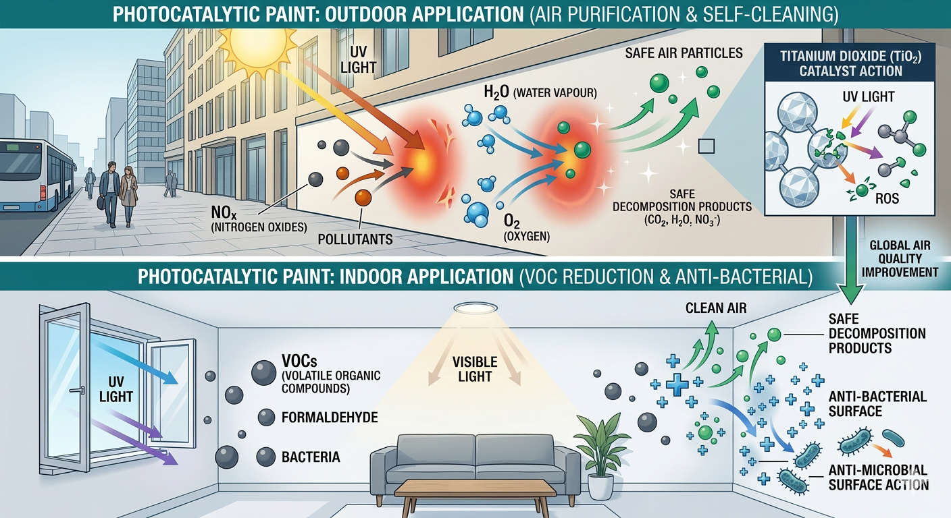

Slide 19
Conclusion
In conclusion, photocatalytic paints offer a promising solution for reducing roadside air pollution.
By using Titanium Dioxide and sunlight, harmful pollutants such as NOx and VOCs can be broken down into safer compounds.
Although challenges still exist, ongoing research is improving the efficiency and durability of these materials.
With further development and large-scale implementation, photocatalytic coatings could become an important technology for sustainable cities and cleaner air.
Thank you.

Slide 20
References
Fujishima et al., 2000
Maggos et al., 2007
Chen & Poon, 2017
Salvadores et al., 2020
Geng et al., 2022
Wang et al., 2023
Ghamarpoor et al., 2024
Ma et al., 2025

